Slide 1

Artificial Intelligence for Women in Agriculture (AI4WIA) Conference
Application of Artificial Intelligence Innovation in Predictive Agriculture
Abdulwaheed Musa, PhD
Director,
Centre for Artificial Intelligence and Machine Learning Systems (CAMS)
Kwara State University, Malete

Slide 2
Application of Artificial Intelligence Innovation in Predictive Agriculture

Slide 3
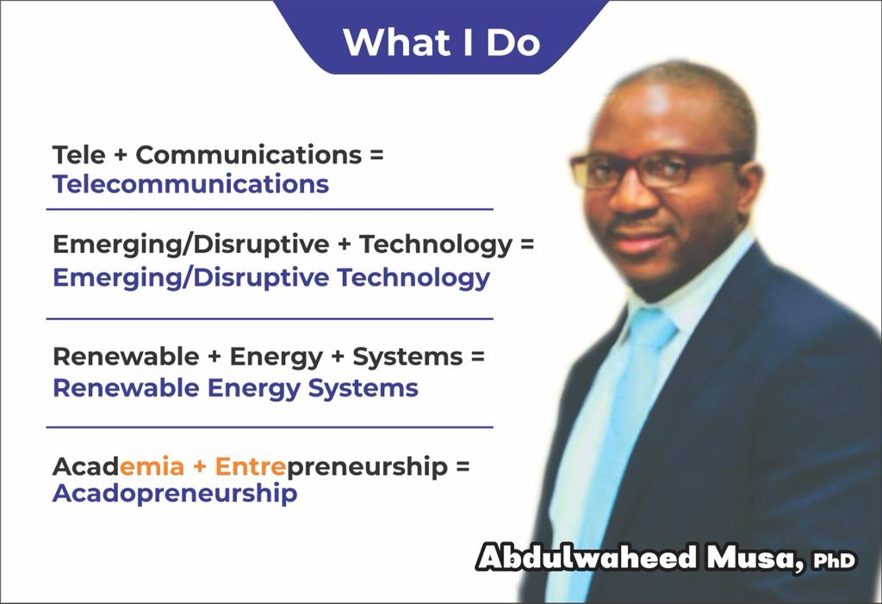

Slide 4
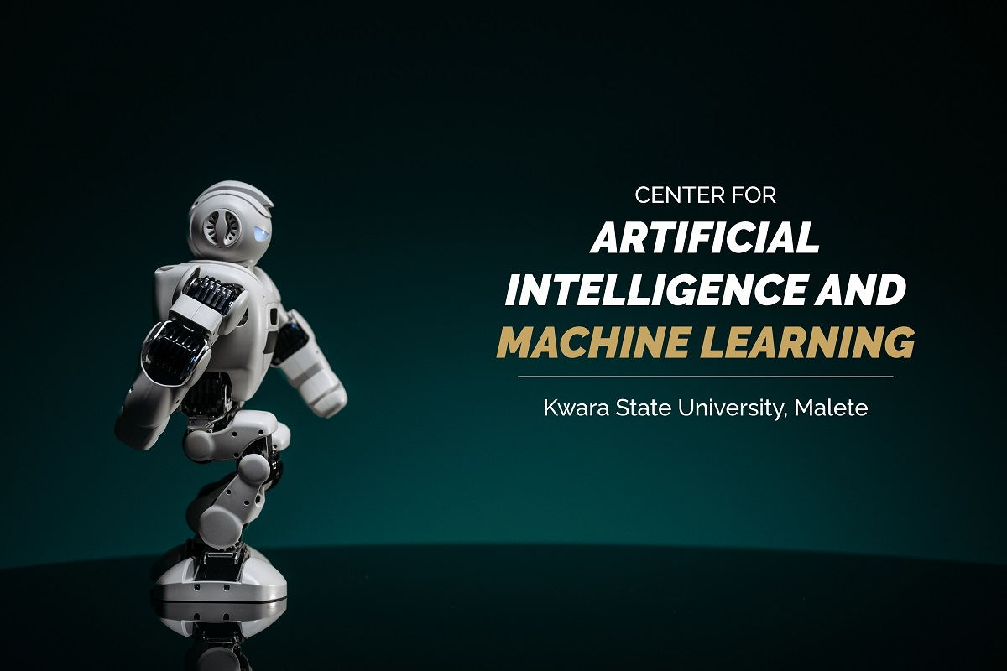

Slide 5


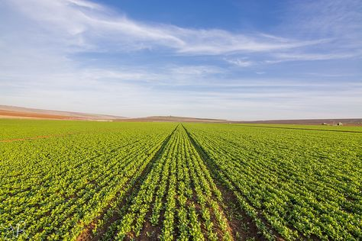
Content
AI in Agriculture: A Paradigm Shift
Introduction
Why Predictive Agriculture is Crucial
Key Applications of AI in Predictive Agriculture
Benefits of AI in Agriculture
Challenges and Future Prospects
Case Studies
Conclusion

Slide 6
1. Introduction
1
2
3
Definition of Predictive Agriculture
Importance of Agriculture in Global Economy
Overview of AI in Agriculture
Predictive agriculture employs data analytics and technology to anticipate crop outcomes and improve farming strategies, enhancing productivity and sustainability.
Agriculture is a fundamental pillar of the global economy, influencing trade, industry, and livelihoods, and it's essential for ensuring food production, economic growth, and rural development on a global scale.
AI in agriculture harnesses advanced technology to automate and improve farming operations, leading to increased productivity, reduced resource wastage, and enhanced decision-making for sustainable food production.

Slide 7
Where are the Typists? What of the then “NITEL Boys”?

Slide 8

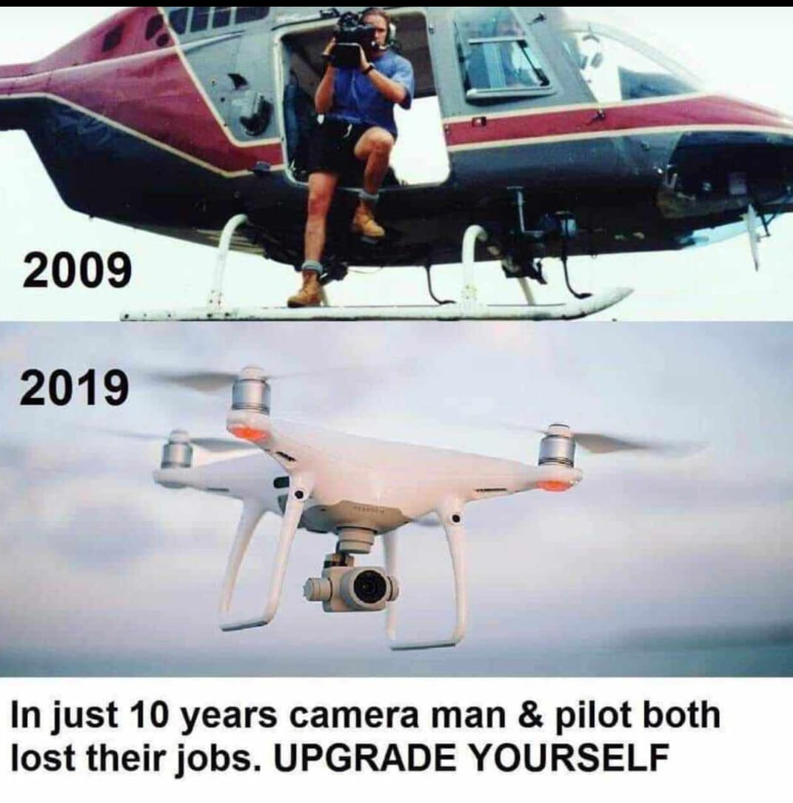
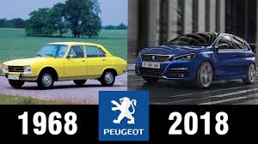
What is the big question?

Slide 9
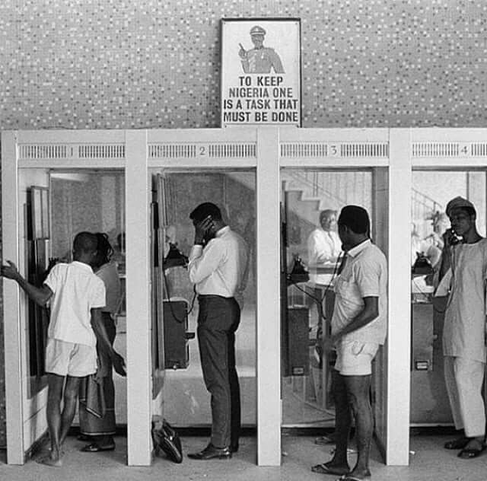

And this?
1984
2023

Slide 10
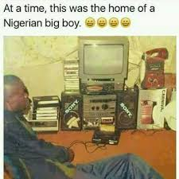
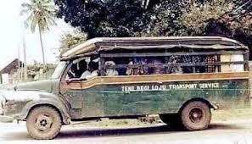
Where are the Big Boys ?
At a time in Nigeria, this was a vehicle owned by a Nigerian big man

Slide 11
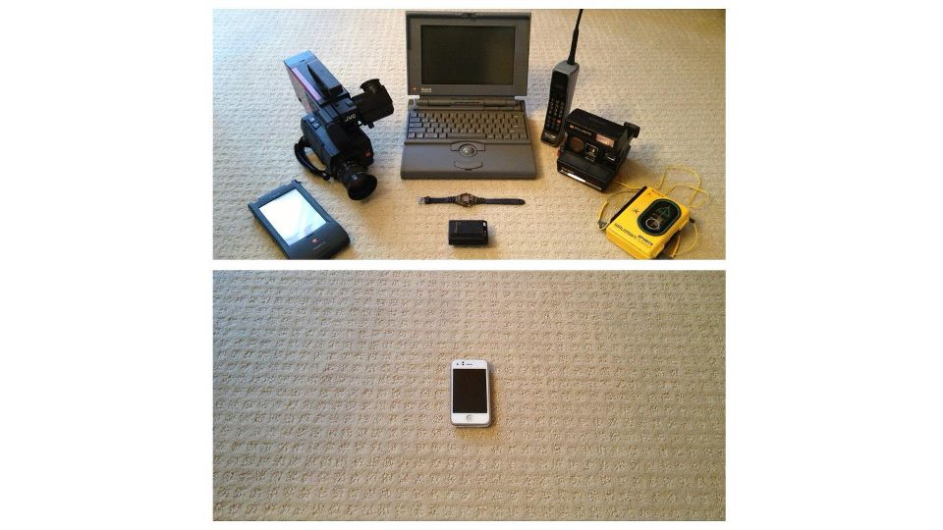
What is the big question?
How prepared are we for 2030?

Slide 12
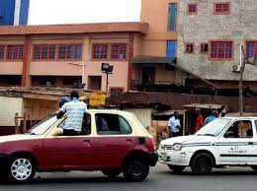

What is the big question?
VS
How prepared are we for 2030?

Slide 13
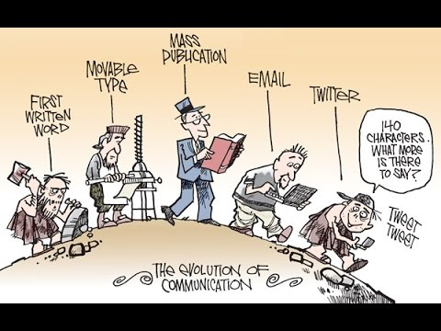
Evolution of Technology
What can you see from this picture?

Slide 14
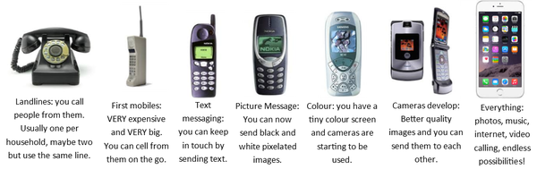
Evolution of Technology-Cont’d
Can you see the timely change in each of this gadget?

Slide 15
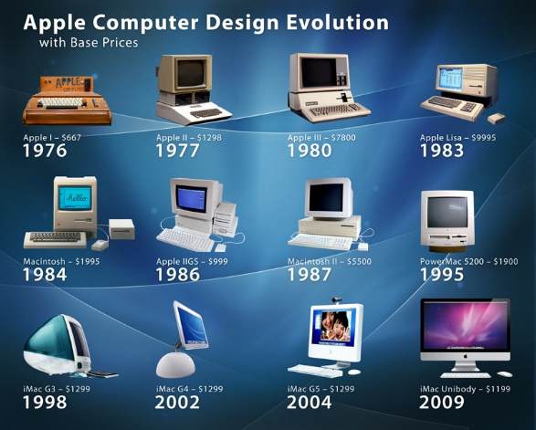
Evolution of Technology-Cont’d
Remember how the computer system transformed from big size low memory machines to small fast machine?

Slide 16
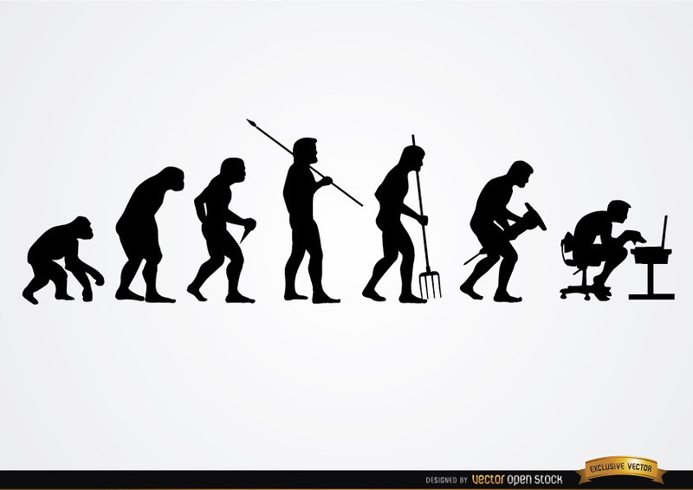

Evolution of Technology-Cont’d
Evolution is about a change in the manner and styles of doing things….

Slide 17

Industrial Evolution
Industry 1.0:
Around 1780s
Introduction of mechanical production facilities with help of water and steam power.
Industry 2.0:
Around 1870.
The era of mass production has begun.
Industry 3.0:
Late 1960s
It enabled production automation through the use of electronic and IT systems.

Slide 18
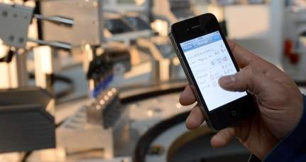
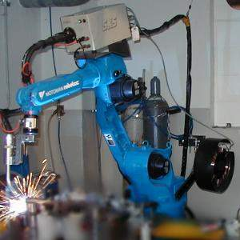
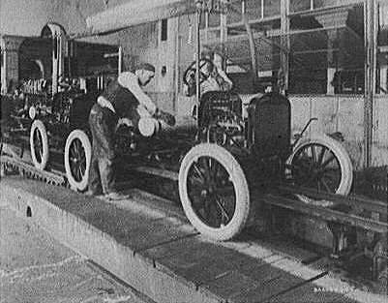
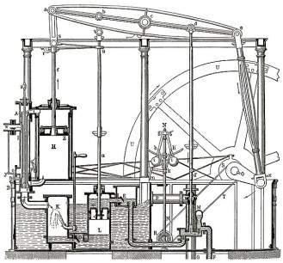
Industrial Evolution - Cont'd
Industry 4.0:
- Through the use of cyber-physical systems.
Meaning: Physical systems such as
machines and robotics
will be controlled by automation systems equipped with machine learning algorithms.
Thus, minimal input from human operators will be needed.
4. Industrial revolution
Based on cyber-physical-
systems
3. Industrial revolution
Through the use of electronics
and IT further progression in
autonomous production
2. Industrial revolution
Mass Production and Assembly Line
Level of complexity
1. Industrial revolution
Introducing mechanical
production machines powered
by water and steam
Industry 1.0
Industry 2.0
Industry 3.0
Industry 4.0
End of the
18th century.
Beginning of the
20th century
Beginning of the
70th
Today
Source: DFKI/Bauer IAO

Slide 19
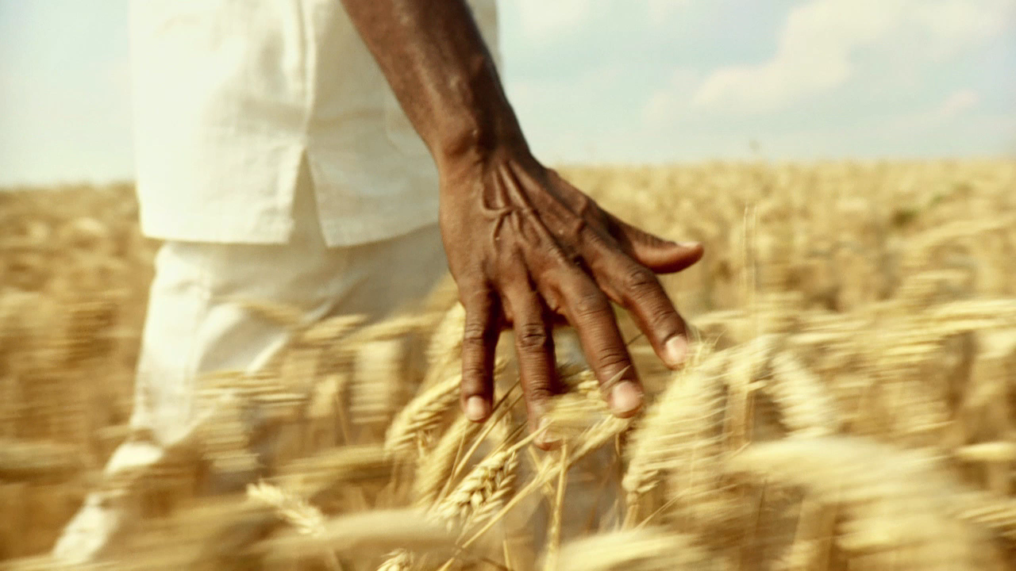
Agriculture in Human Civilization
Transition from hunter-gatherer societies to agricultural societies.

Slide 20
Agriculture in Human Civilization
Agriculture, as the cornerstone of human civilization, has profoundly shaped societies across millennia.
Early Agricultural Societies
Agriculture in Ancient Civilizations
Medieval and Renaissance Agriculture
Industrial Revolution and Modern Agriculture
Fourth Industrial Revolution and AI Innovations

Slide 21
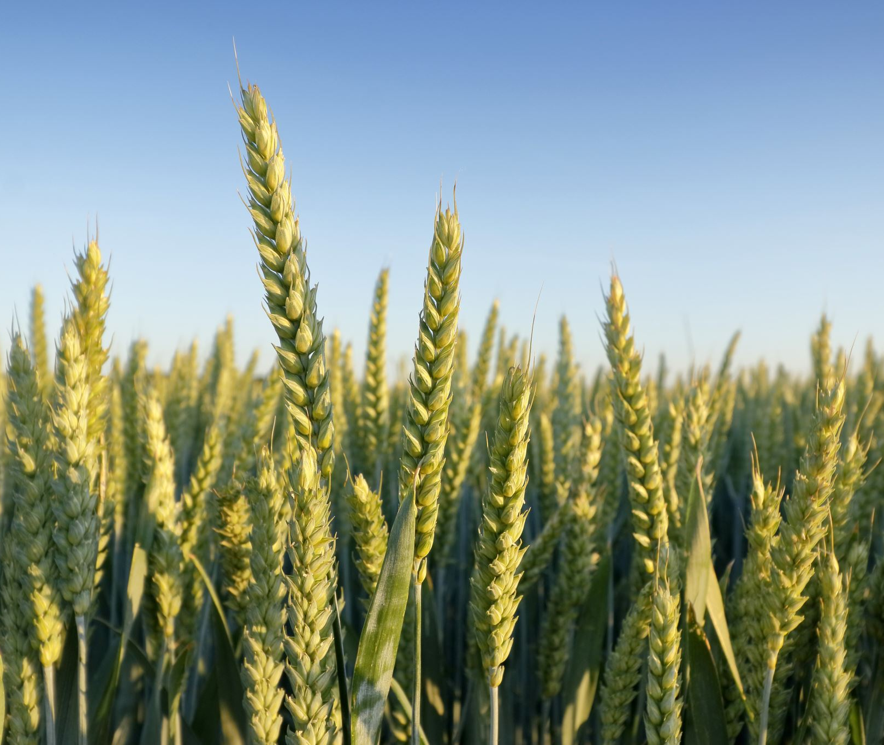
Early Agricultural Societies
Importance of the Neolithic Agricultural Revolution.
Transition from nomadic hunting-gathering to settled farming marked the beginning of agriculture in the Fertile Crescent, leading to permanent settlements and surplus food production.

Slide 22
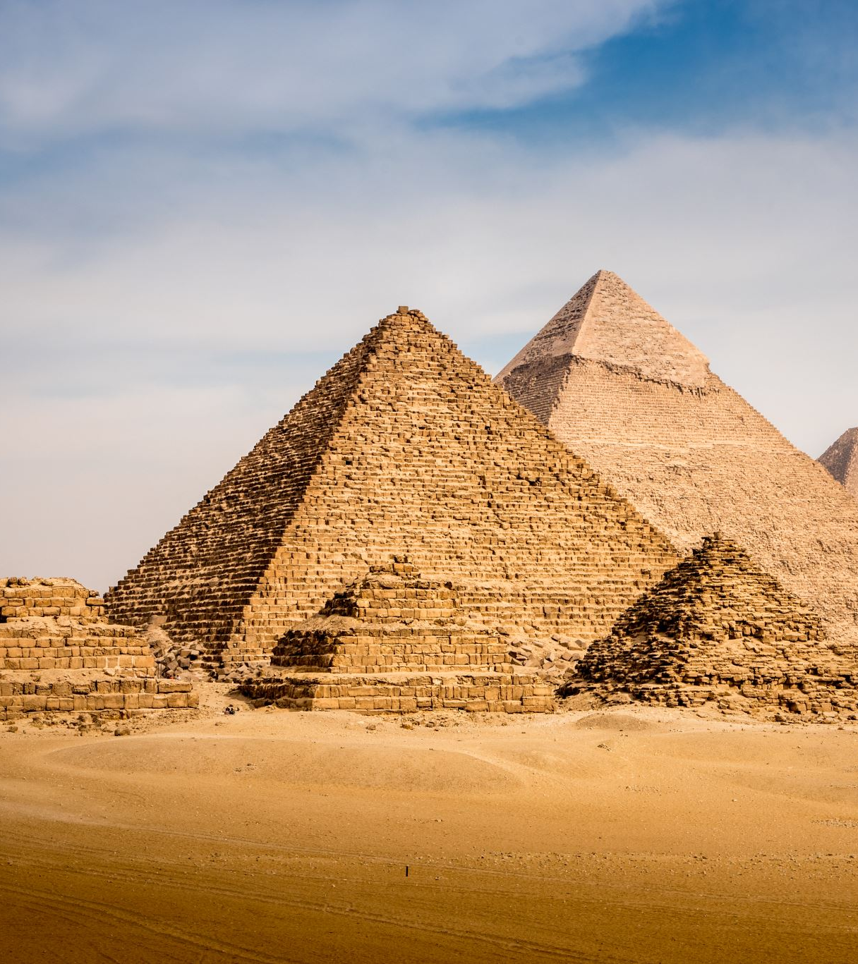
Agriculture in Ancient Civilizations
Agriculture in Mesopotamia, Ancient Egypt, and the Indus Valley Civilization.

Slide 23
Medieval and Renaissance Agriculture
15th Century
- Feudal Europe (9th–15th Century): Manor-based agriculture under feudalism sustained medieval Europe.
18th Century
- Agrarian Revolution (18th Century): Technological advancements like the seed drill and crop rotation enhanced productivity during the British Agricultural Revolution.

Slide 24
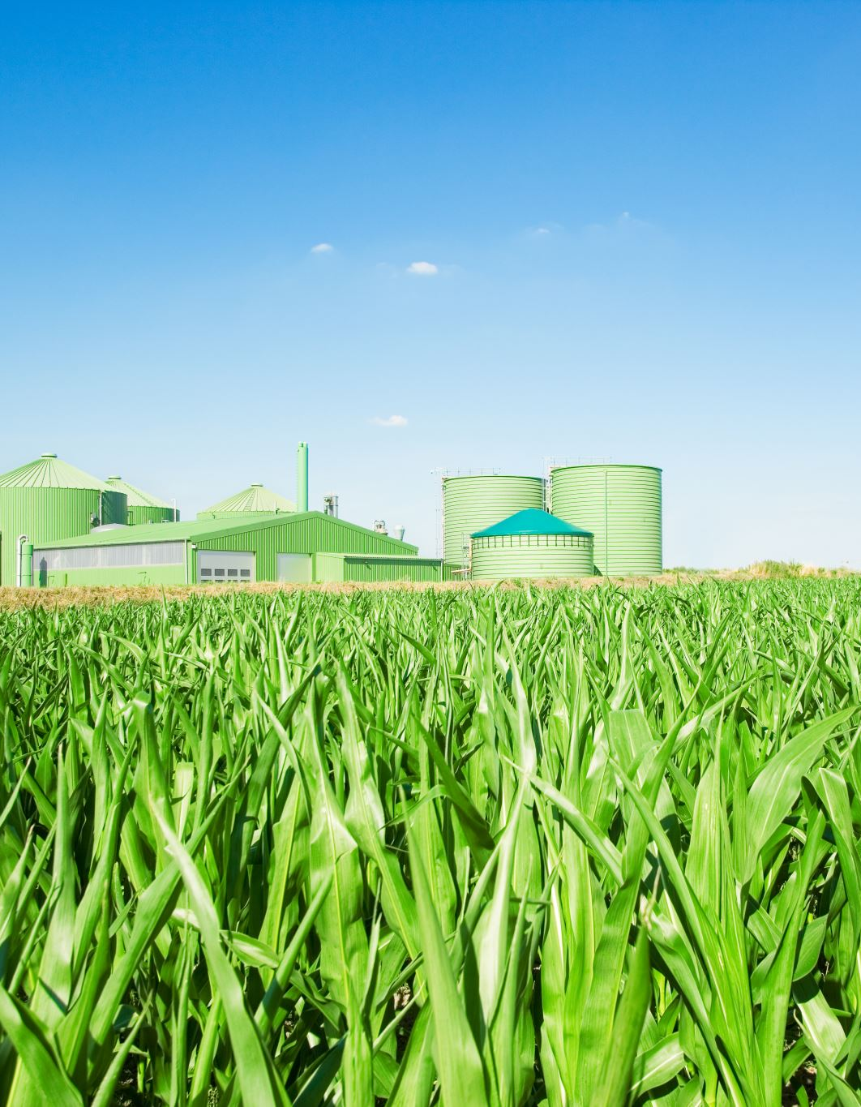
Industrial Revolution and Modern Agriculture
- Industrial Revolution (18th–19th Century): Mechanization transformed farming, leading to increased yields and urbanization.
- Green Revolution (mid-20th Century): The introduction of high-yielding crop varieties, fertilizers, and pesticides bolstered agricultural production worldwide.

Slide 25
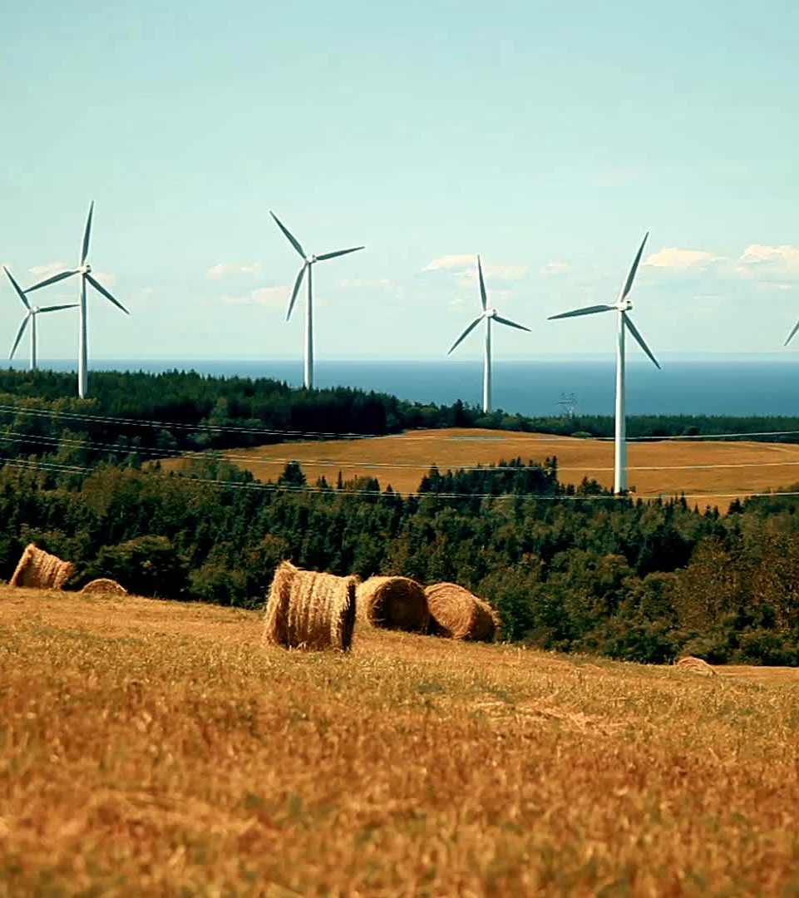
Fourth Industrial Revolution and AI Innovations
- Fourth Industrial Revolution (21st Century): Integration of AI, IoT, and robotics revolutionized industries, including agriculture, leading to precision farming and smart agricultural practices
- AI Innovations: AI-driven technologies predict weather patterns, optimize resource usage, and aid in crop monitoring, ensuring sustainable and climate-smart farming practices.

Slide 26
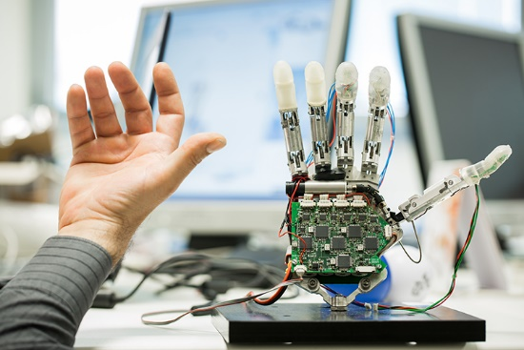

What is Artificial Intelligence?
Simply put:
Artificial
+
Intelligence
=
Artificial Intelligence

Slide 27
Fundamental Concepts of AI
Machine Learning
Deep Learning
Natural Language Processing
Robotics
Computer Vision

Slide 28
Brief History of AI
In ancient times, inventors made things called "automatons" which were mechanical and moved independently of human intervention. The word "automaton" comes from ancient Greek, and it means "acting of one's own will."
The field of AI research was founded at a workshop held on the campus of Dartmouth College, USA during the summer of 1956. Many of the attendees predicted that a machine as intelligent as a human being would exist in no more than a generation, and they were given millions of dollars to make this vision come true. From 1957 to 1974, AI flourished. Computers could store more information and became faster, and more accessible. Machine learning algorithms were developed to enable machines to learn from data and improve their performance over time without being explicitly programmed.
In the 1960s, AI research gained momentum with the development of the first AI programming language, LISP, by John McCarthy. In the 1980s, there was the development of new techniques such as backpropagation, which enabled the training of neural networks.
The evolution of AI has been a remarkable journey, with countless breakthroughs and innovations. AI has transformed industries and our daily lives. With advances in machine learning, natural language processing, and computer vision, AI is no longer a futuristic dream but a current reality.

Slide 29
AI Tools and Innovation in Predictive Agriculture
Predictive Analysis
Predict crop yields
Drones
Detect pests and diseases
Livestock health monitoring
Improved Soil Health Monitoring
Precision Agriculture
Automatic Weeding

Slide 30
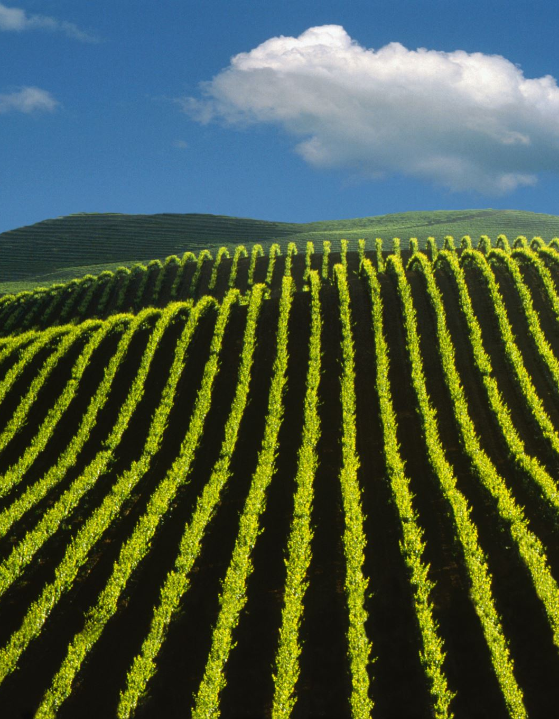
Predictive Analysis
AI algorithms analyze historical and real-time data, predicting weather patterns and optimizing planting schedules, enabling farmers to adapt to changing climate conditions. This can help farmers make better decisions about planting, irrigation, and harvesting.

Slide 31
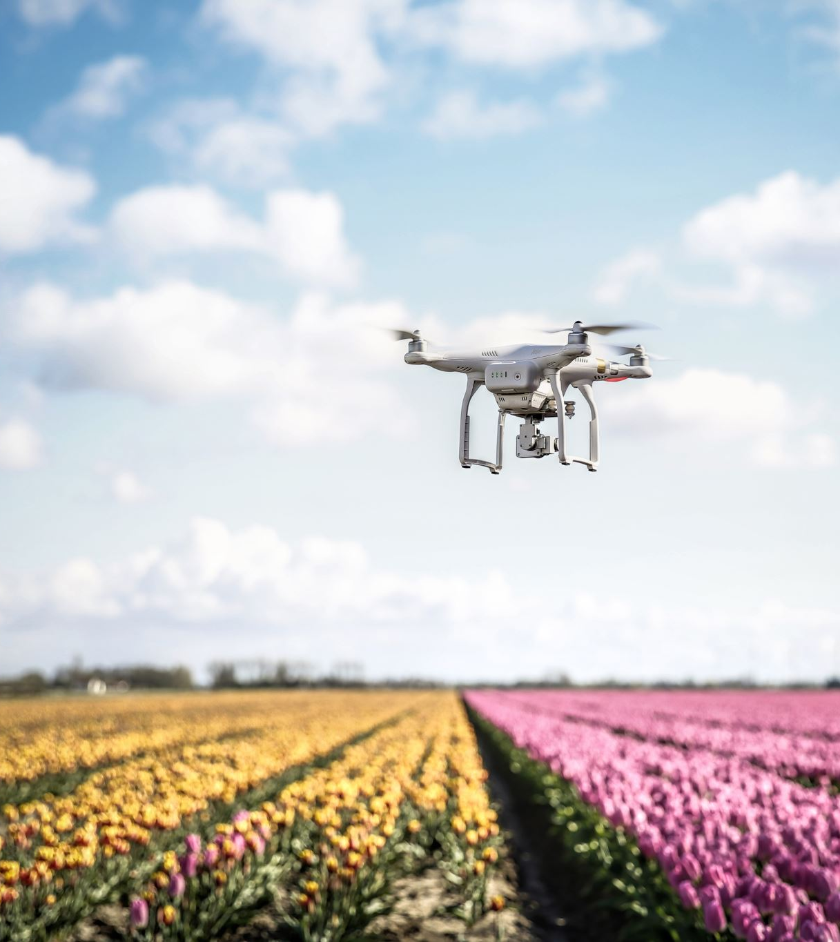
Drones
Drones equipped with computer vision capabilities can be used for crop and soil monitoring and spraying pesticides more efficiently and precisely.

Slide 32

Detect pests and diseases
AI-powered pest and disease detection systems can help farmers identify and respond to pest and disease outbreaks early on before they cause significant damage to crops. These systems can analyze data from a variety of sources, including satellite imagery, drone footage, and ground-based sensors, to identify the presence of pests and diseases.

Slide 33
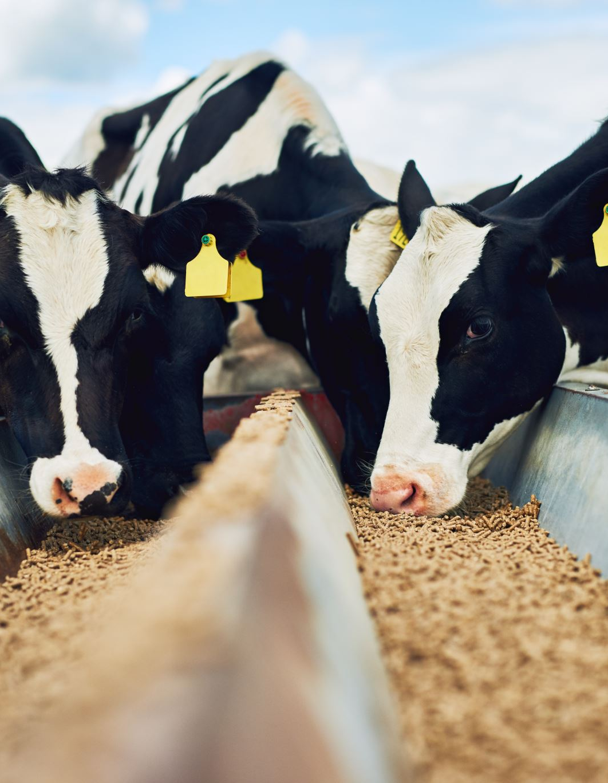
Livestock health monitoring
AI-powered livestock health monitoring systems can help farmers to monitor the health and well-being of their animals in real-time. These systems can analyze data from a variety of sources, such as wearable sensors and video cameras, to identify potential health problems early on.

Slide 34
Climate Change and Its Impact
Why Predictive Agriculture is Crucial
Food Security and Sustainable Agriculture
The Need for Precision Farming

Slide 35

AI in Agriculture: A Paradigm Shift
Machine Learning and Deep Learning
IoT and Sensor Technology
01
Internet of Things (IoT) in predictive agriculture utilizes interconnected devices and sensors to collect real-time data on soil conditions, weather, and crop health, enabling precise decision-making and resource management for optimized farming practices.
Machine Learning in predictive agriculture employs algorithms to analyze data and make forecasts, while Deep Learning, a subset of Machine Learning, uses neural networks to handle complex, high-dimensional data, improving accuracy in agricultural predictions and decision-making.
04
02
Data Analytics and Predictive Models
Robotics and Automation
03
Robotics and automation in predictive agriculture involve the use of autonomous machines and systems to perform tasks like planting, harvesting, and crop monitoring, increasing efficiency and reducing labor requirements while enhancing productivity and data collection.
Data analytics in predictive agriculture involves examining historical farming data to identify trends and patterns, while predictive models use this information to make projections, such as crop yields, pest infestations, or weather-related impacts, helping farmers optimize their strategies and resource allocation.

Slide 36
Empowering African Women Farmers
Educational Initiatives: AI-powered educational programs provide tailored guidance, empowering women farmers with knowledge on sustainable farming practices.
Access to Resources: AI facilitates efficient resource allocation, ensuring women farmers have access to essential resources, and mitigating the impact of climate change on their agricultural endeavors.

Slide 37
Case Studies of AI Implementation in Agriculture
John Deere's Autonomous Tractors
IBM's Watson Decision Platform for Agriculture
CropX - AI-Based Soil Monitoring

Slide 38

Case Studies
The Kwara State University in Nigeria organized a training program for women farmers on how to mitigate the effects of climate change on agricultural practice. The program, tagged “Artificial Intelligence For Women In Agriculture” (AI4WIA), aimed to train women farmers on the use of AI to mitigate the effects of climate change on agricultural production.
There is another program tagged “Artificial Intelligence For Women In Aquaculture” (AI4WA), aimed to empower women in Aquaculture. It is a project sponsored by the Gender and Responsible Artificial Intelligence Network (GRAIN) in Africa.
Another example is the AI Institute for Food Systems at UC Davis, which is undertaking a project to develop “an AI-enabled framework for near real-time monitoring and a prediction that are generalizable across many specialty crops,” with the aim to provide farmers with real-time crop insights, helping them to identify which areas need irrigation, fertilization, or pesticide treatment.

Slide 39
Benefits of AI in Agriculture
Increased Crop Productivity
Resource Efficiency
Reduced Environmental Impact
Data-Driven Decision-Making
Economic Benefits

Slide 40
Challenges and Future Prospects
Data Privacy and Security
Accessibility and Adoption
Policy and Regulation
Research and Development
The Future of AI in Agriculture

Slide 41
Conclusion
Q&A

Slide 42
Thank You
Engr. Abdulwaheed Musa, PhD

